Slide 1
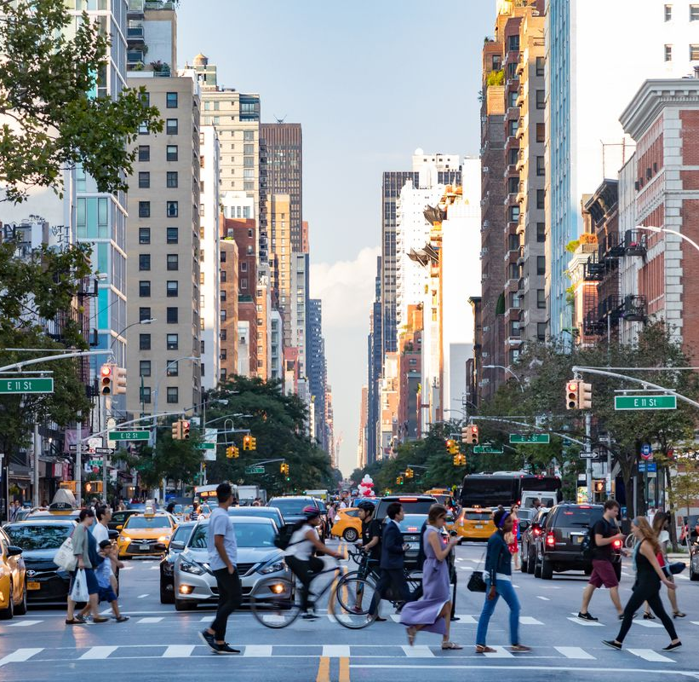
NYC Motor Vehicle Crashes
Syracuse University IST 687 Fall 2021
By Nora Lin and TEAM

Slide 2
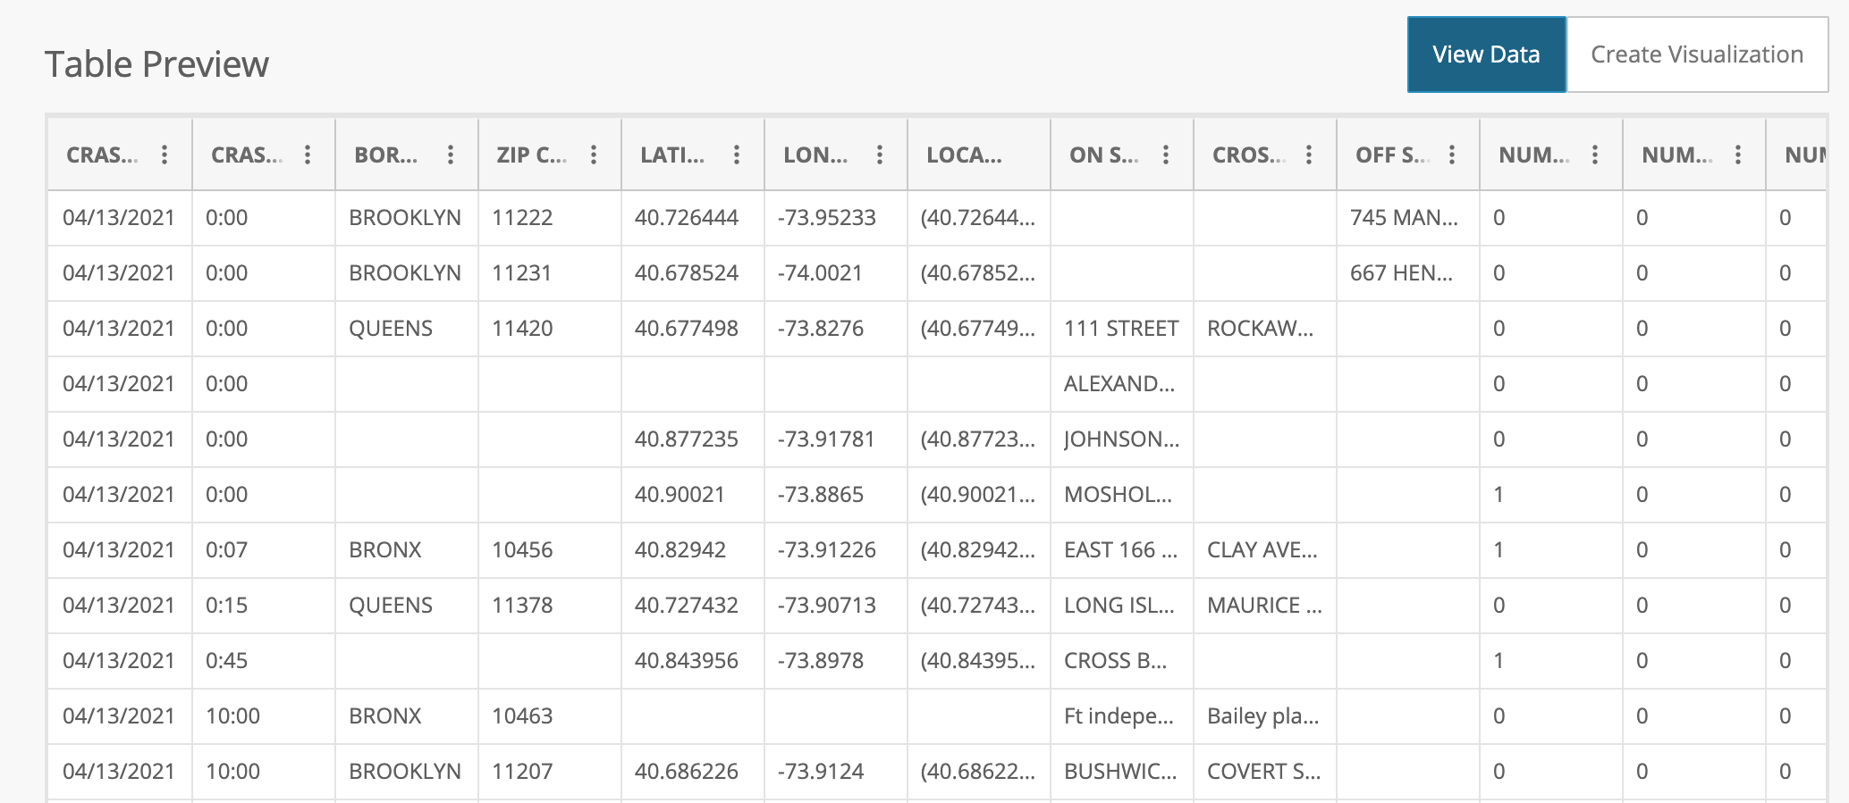
About the Data
02
The "Motor Vehicle Collisions – Crashes" dataset contains details about crash events in New York City. Each row represents a crash. A police report (MV104-AN) is required when the crash involves a person(ie pedestrian, cyclists, or motorist) is injured or killed or $1,000 worth in damages.
The original dataset contains about 1.8M observations. Our team has subset this data into a two-year period, 2018-2019. The data is available through the following link: https://data.cityofnewyork.us/Public-Safety/Motor-Vehicle-Collisions-Crashes/h9gi-nx95
Our dataset contains 443,045 observations with 29 variables.

Slide 3
Variable
03
Below are a list of all the variables within the dataset. We have a good variety of variables to explore here which include geographic information, date and time information as well as more detailed crash information.
Time and Location Information:
Crash Time
Crash Date
Borough
Zip Code
Longitude
Latitude
Location
Off street name
On street name
Crash Details:
Collision ID
Number of persons injured
Number of persons killed
Number of pedestrians injured
Number of cyclists injured
Number of motorist injured
Number of pedestrians killed
Number of cyclists killed
Number of motorists killed
Cash Factors:
Vehicle Code Type 1-5
Contributing Factor 1-5

Slide 4
Our Process
04
Picking our data
Changed our data set
Cleaning pt. 1
Cleaning pt. 2
Thought about questions we wanted to ask
We found a lot of missing data (N/A)
Data exploration/ Mapping
Regression
Revised our questions
Changed white spaces to underscores
Predictions
Changed our dataset because it the data was too clean
Clean up the borough, zip code, latitude and longitude data.
Separate the hours, minute and second columns
Checked for outliers
Looked into what data we wanted to explore
The original data set was clean
Figure out what type of maps and graphs we wanted to display
Tried 3 regression models and came out with similar R-values
How did the pandemic affect our trends?
Type of information
Chose to focus on boroughs, time of day, year to year data, type of incident, total incidents, incidents by boroughs

Slide 5
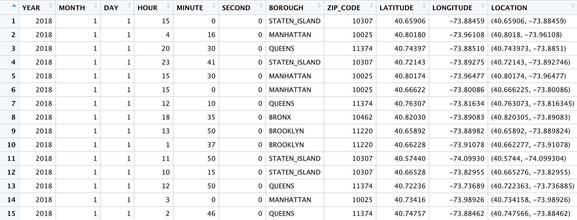
Final Cleaned Dataset
05
Out of our 443,045 data point entries, we started off with 156,791 NA values for Borough.
With our code, we were able to use the min max of longitude and latitude to fill in these NA values.
Ultimately, we filled in 132,516 NA values for the Borough Column.

Slide 6
Data Exploration: Total Incidents
06
We decided to start by looking at Total Incidents, a broad examination of incidents that include Motorists, Cyclists and Pedestrians.
What we are looking for:
Trend of total incidents from 2018 to 2019
How Total incidents compare each Month?
How Total incidents compare each Day of the Week?
Which hours of the day have the most incidents?

Slide 7
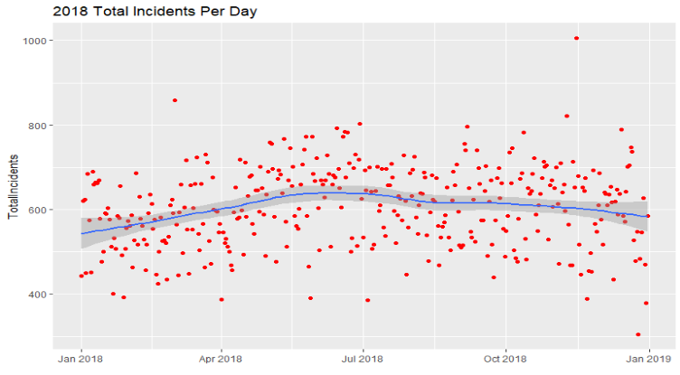
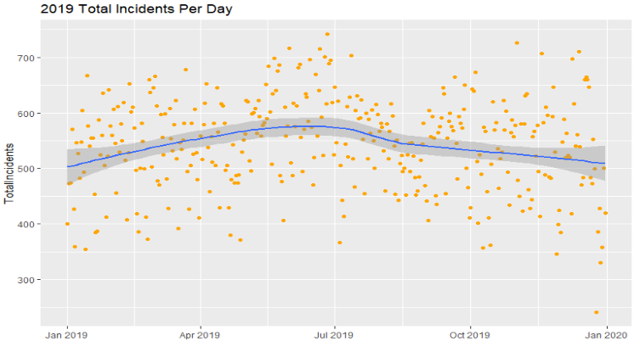
Trend of Total Incidents per Year
07
The dataset presents a relative trend of incidents by year. We used lm_smooth( ) to show this trend.
Each dot represents a day and the total number of incidents that occurred.
The number of total incidents peaks between April and July in both 2018 and 2019.
The total number of incidents through the year remains consistent between 400 and 800 number of incidents.

Slide 8
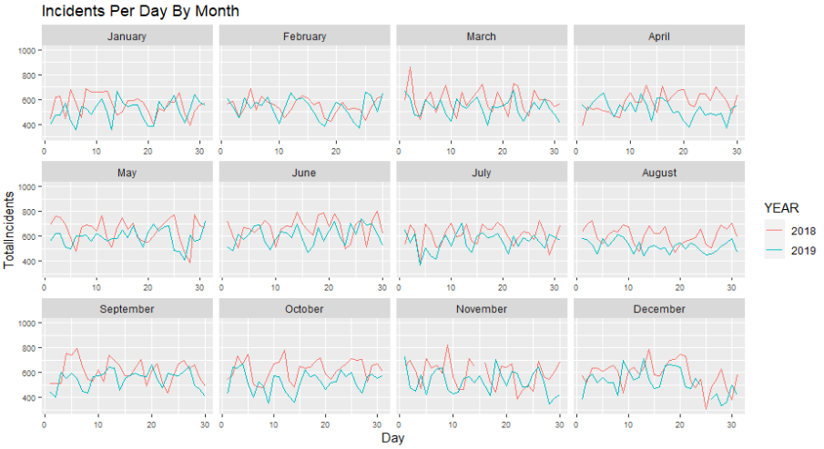
Total Incidents: Monthly Comparison
08
Plotted days on the x-axis and number of incidents on the y-axis for each month.
Across all 12 months, the trend in 2019 follows the trend in 2018.
Many months follow almost the exact same pattern.

Slide 9
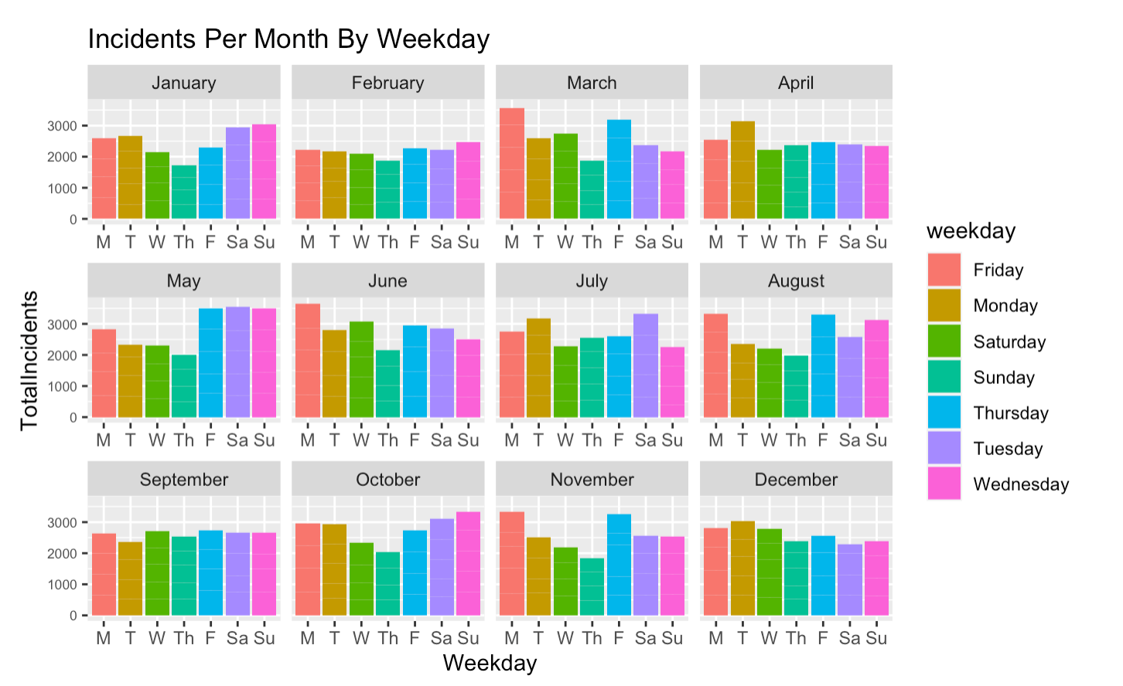
Total Incidents: Daily Comparison
9
This chart shows an aggregate of all incidents for each day of the week (2018 and 2019 combined).
You could look at this chart and see which days incidents are most likely to occur.
To point out a couple of days, Monday in March and weekends in May have over 3,000 recorded incidents in 2018 and 2019.
Most days of the week do not change much from month to month and remain close to the average of about 2,500.

Slide 10
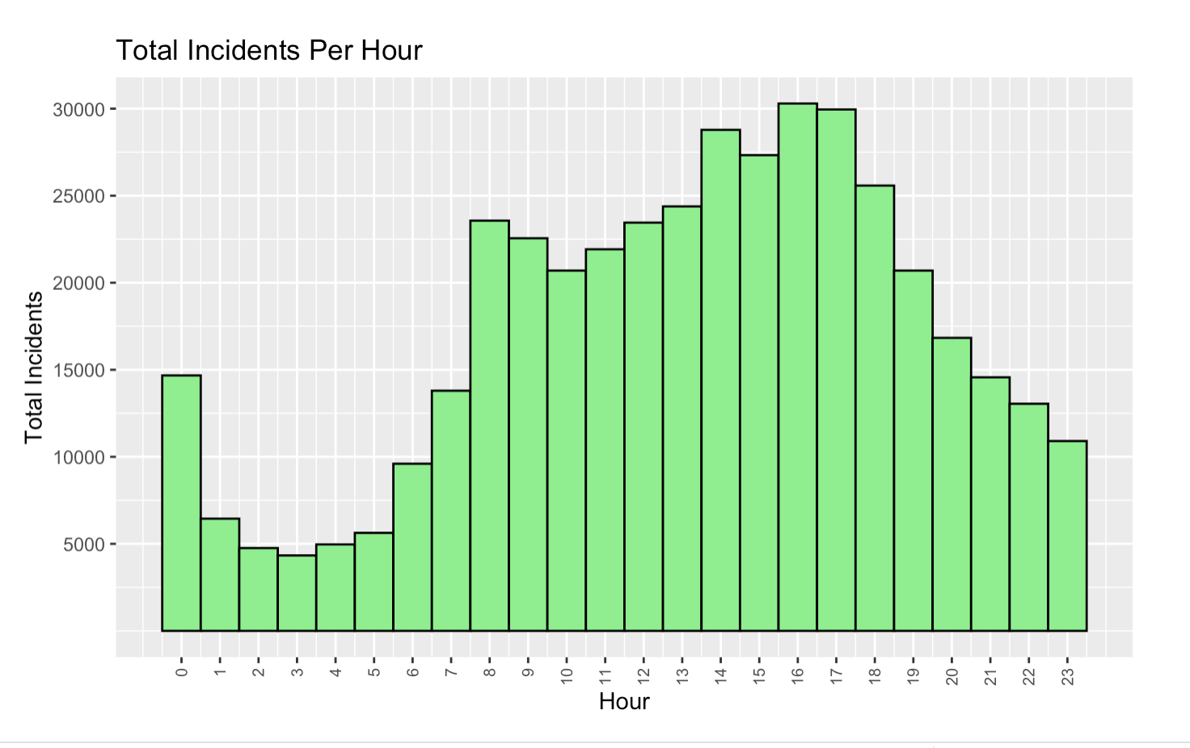
Total Incidents by the Hour
10
Since we cleaned our data from a single variable that contained the date and time into separate variables for Month, Day, Year, Hour, Minute, and Second, we were able to explore which hours the incidents occurred.
The graph to the left shows a bimodal distribution.
The number of total incidents between 7am and 11pm presents closely to a normal distribution.
As expected, we see incidents increase and remain higher during hours during the day since more people would be awake.
We can see a sharp spike in the number of incidents between 7am and 8am which could be the result of the morning commute.

Slide 11
Data Exploration: Total Incidents by Borough
11
After looking at the numbers for total incidents, we decided to look more closely at the incidents for each Borough of the City.
What we are looking for:
How do the incidents vary per Borough?
Do different Boroughs have different hourly highs?

Slide 12
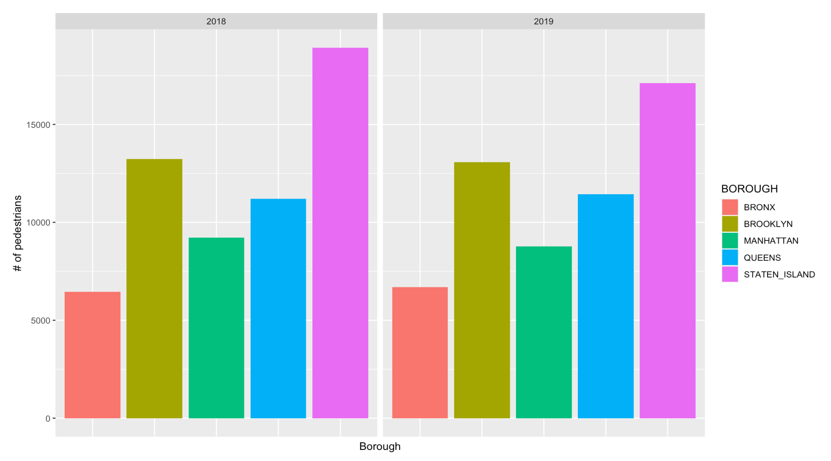
Total Incidents by Borough
12
We can see clear ranking of the different borough with regards to the total number of incidents in 2018 and 2019.
Staten Island has the most number of total incidents and the Bronx has the least number of total incidents.
Trend is almost identical from 2018 to 2019.
Insight: This trend is not surprising. Staten Island, queens and Brooklyn are larger than Manhattan and the Bronx

Slide 13
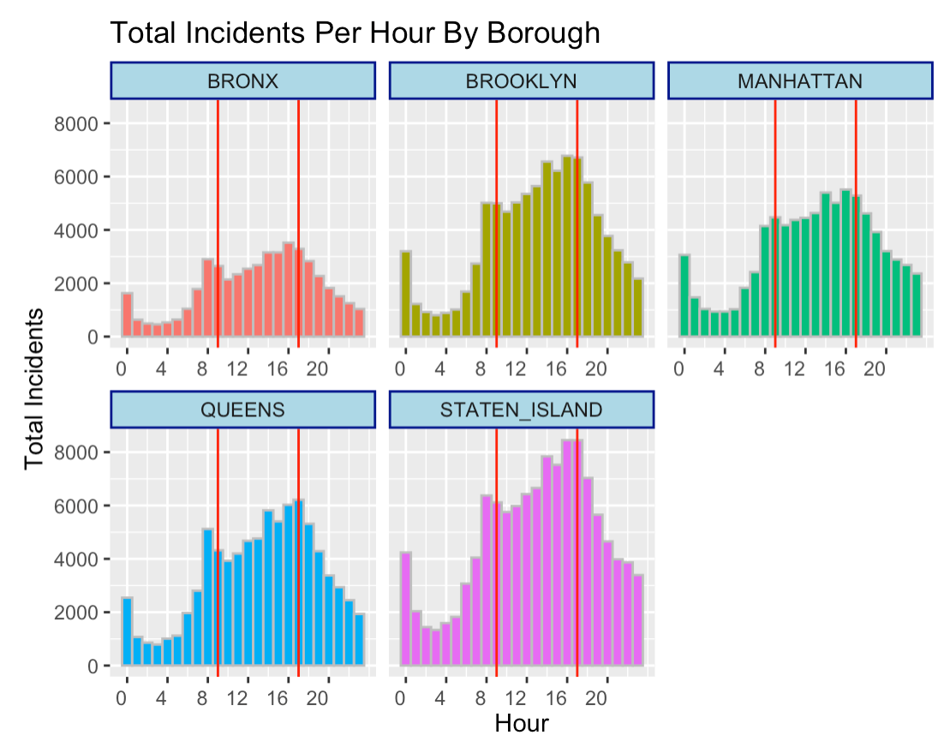
Total Incidents by the Hour
13
Breakdown of incidents per hour for each Borough.
The vertical red lines represent 8am to 5pm, a typical workday.
The majority of total incidents tend to occur during the middle of the day/after-mid rather than the early and later hours.
This is expected because most of the population is active during these hours.

Slide 14
Data Exploration: Pedestrians vs Cyclist & Motorist
14
We wanted to narrow down our analysis to once type of incident category and decided to focus on Pedestrians. This is because:
A majority of NYC residents don’t own a car in the city.
Motorist category had a lot of clutter and potentially bad data due to manual recording of vehicle codes.

Slide 15
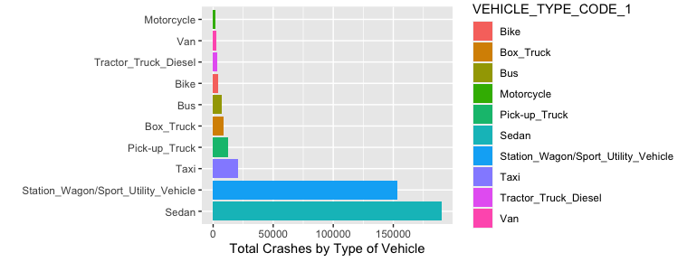
Motorist Vehicle Codes
Vehicle Code Type
15
There are 562 unique values within the Vehicle Code Type column (we have highlighted some of our favorites below).
This messiness in data is potentially due to the human error when filling out the incident report form.
Most incidents are caused by Sedans and SUVs however there are hundreds of other vehicle types listed.
Decided to stay away from vehicle type and therefore also Motorist incidents for now due to messiness.
Insight: One would expect Taxis to be the greatest frequency in the Motor Vehicle Types. However, in NYC, taxis primarily operate in Manhattan. Since our data includes otther boroughs, the high frequency of Sedans and Station Wagons is not surprising.

Slide 16
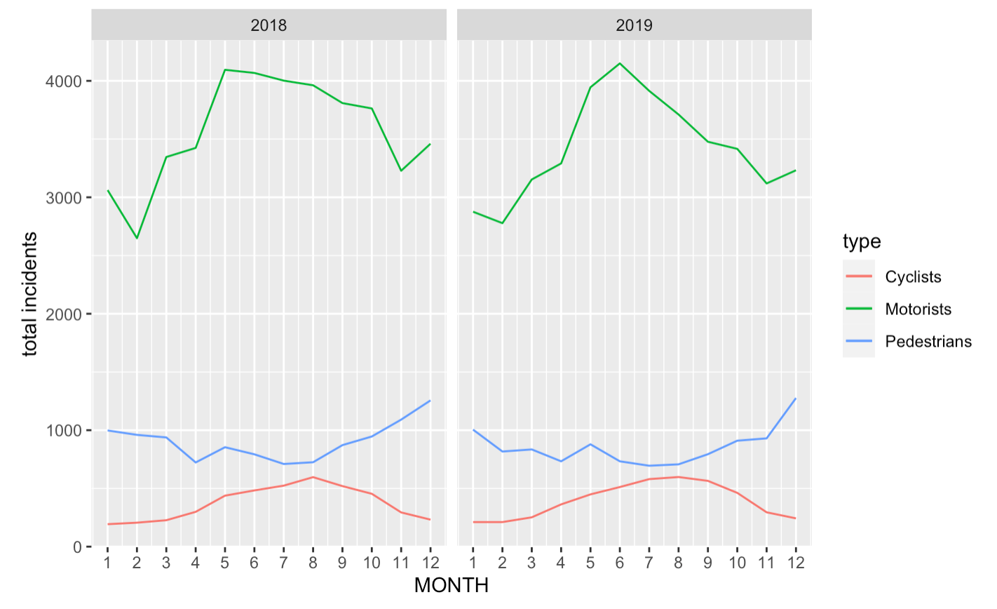
Pedestrians, Cyclists and Motorists
16
The dataset shows relation of total number of incidents by type: Motorists, Cyclists and Pedestrians.
For the purpose of our data investigation, we want to focus in on pedestrians.
However, we would like to note that our dataset has the potential to provide insights for cyclists and motorists.

Slide 17
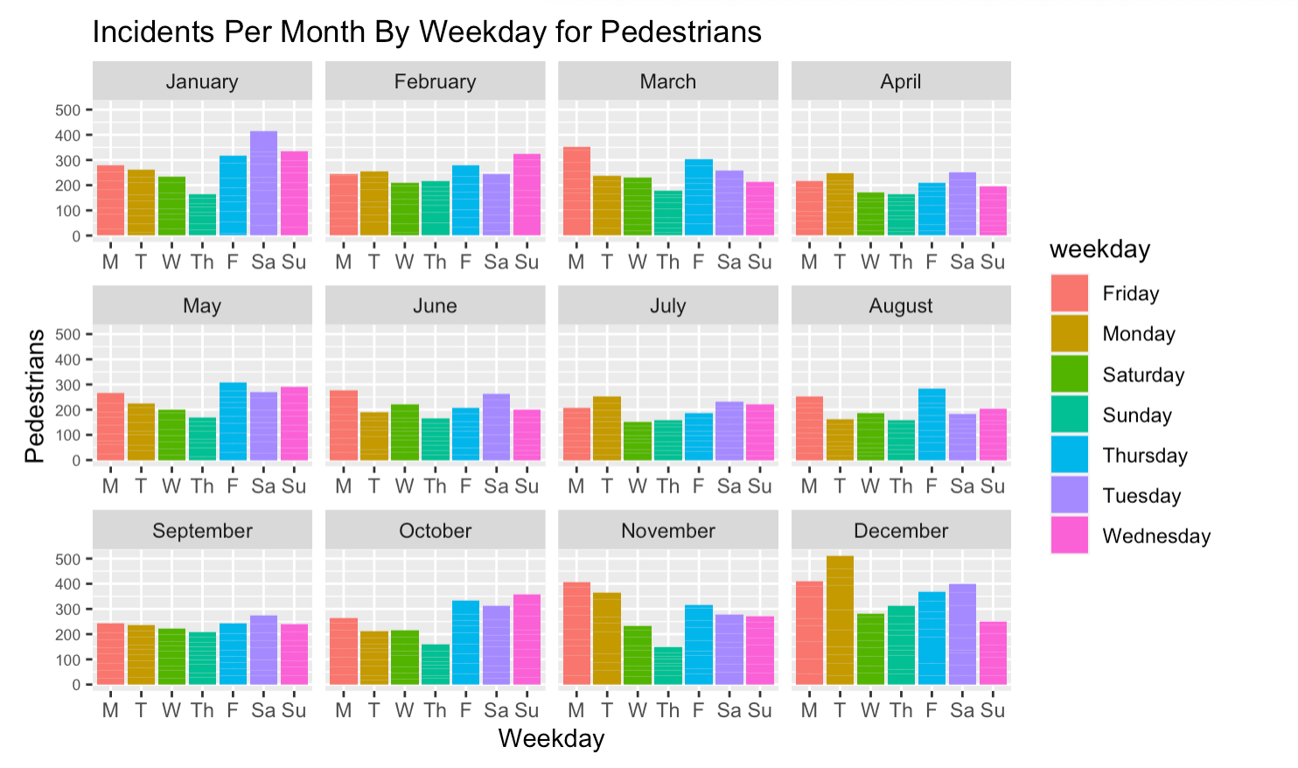
Pedestrian Incidents: Daily Comparison
17
This chart shows an aggregate of all Pedestrian incidents for each day of the week (2018 and 2019 combined).​
Like we saw in the daily comparison of total incidents, there isn't much variation between days of the week per month.
​

Slide 18
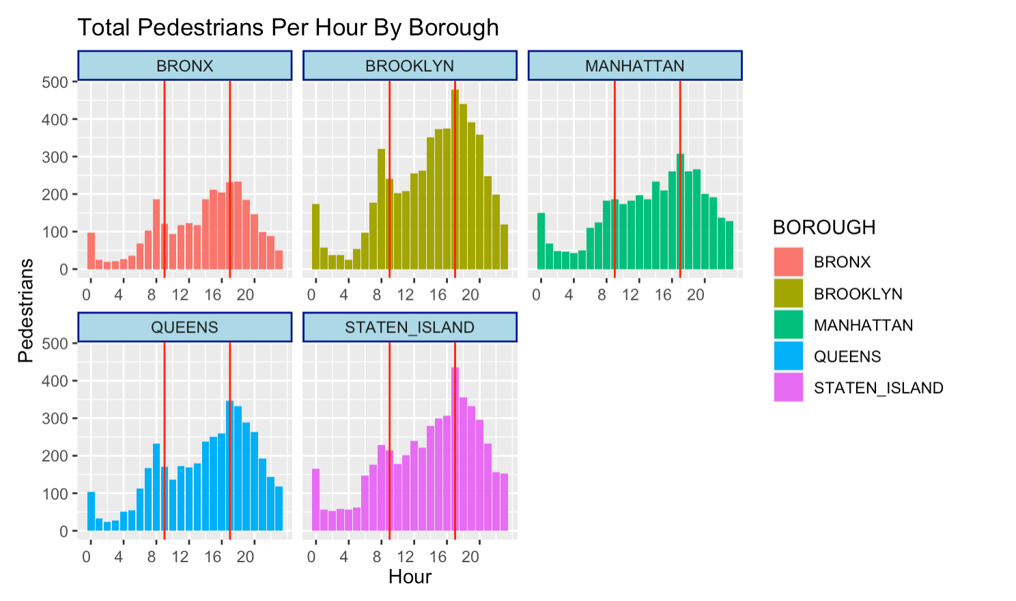
Pedestrians Incidents per hour by Borough
18
Breakdown of Pedestrian incidents per hour for each Borough.
Insights remain the same: The majority of total incident tend to occur during the middle of the day/after-mid rather than the early and later hours.
This is expected because most of the population is active during these hours.

Slide 19
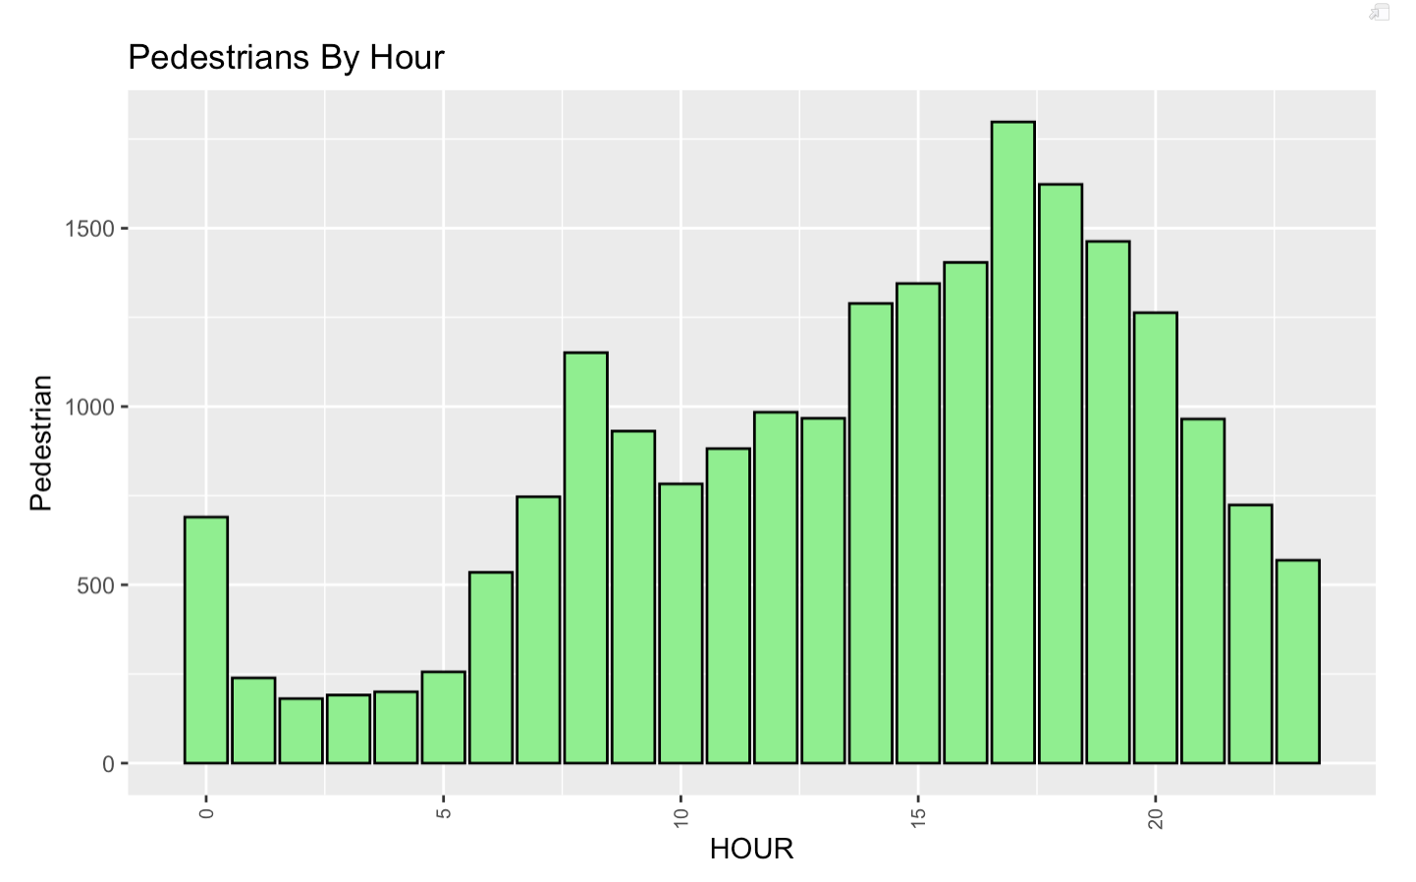
Pedestrians per hour
19
As expected, we see incidents increase and remain higher during hours during the day since more people would be awake.
We can see a sharp spike in the number of incidents between 7am and 8am which could be the result of the morning commute.
Pedestrian incidents per hour follow the total incidents trend

Slide 20
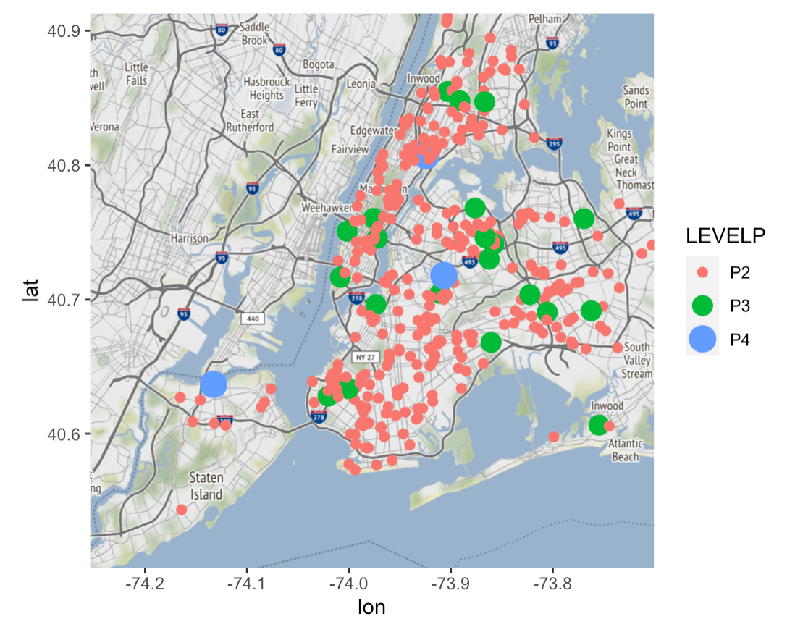
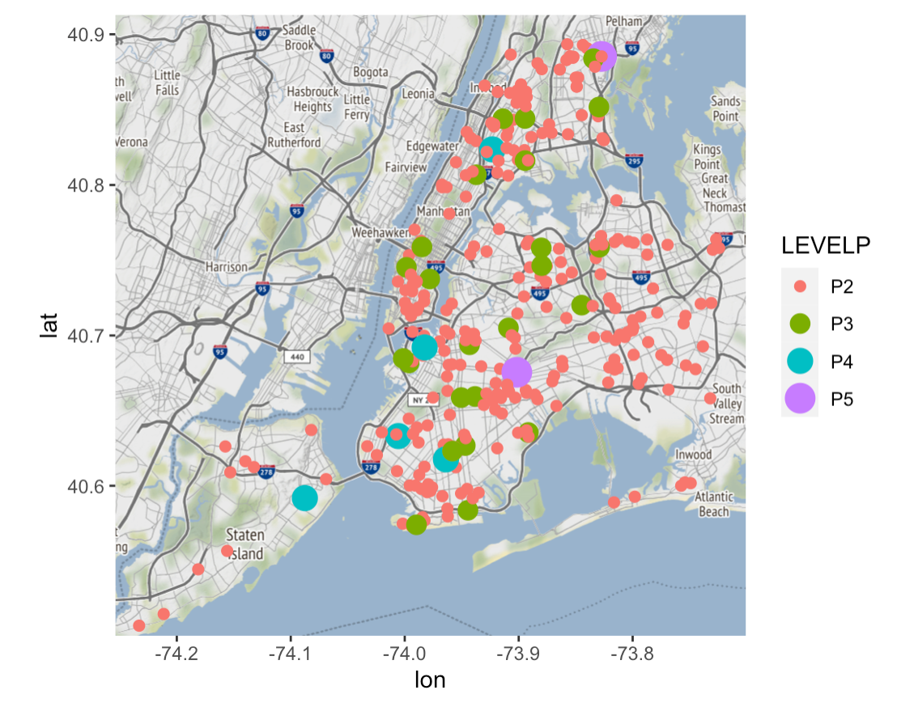
Geographic Pattern: Pedestrians Injured Levels
20
The maps below show the number of pedestrians injured. Levels: 1, 2, 3, 4, and 5.
Levels 1-4 represent the number of pedestrians injured.
Level 5 represents 5 or more pedestrians injured.
We can see that in 2019, there were a couple of incidents with 5 or more pedestrians injured while there were no such incidents in 2018
2018
2019

Slide 21
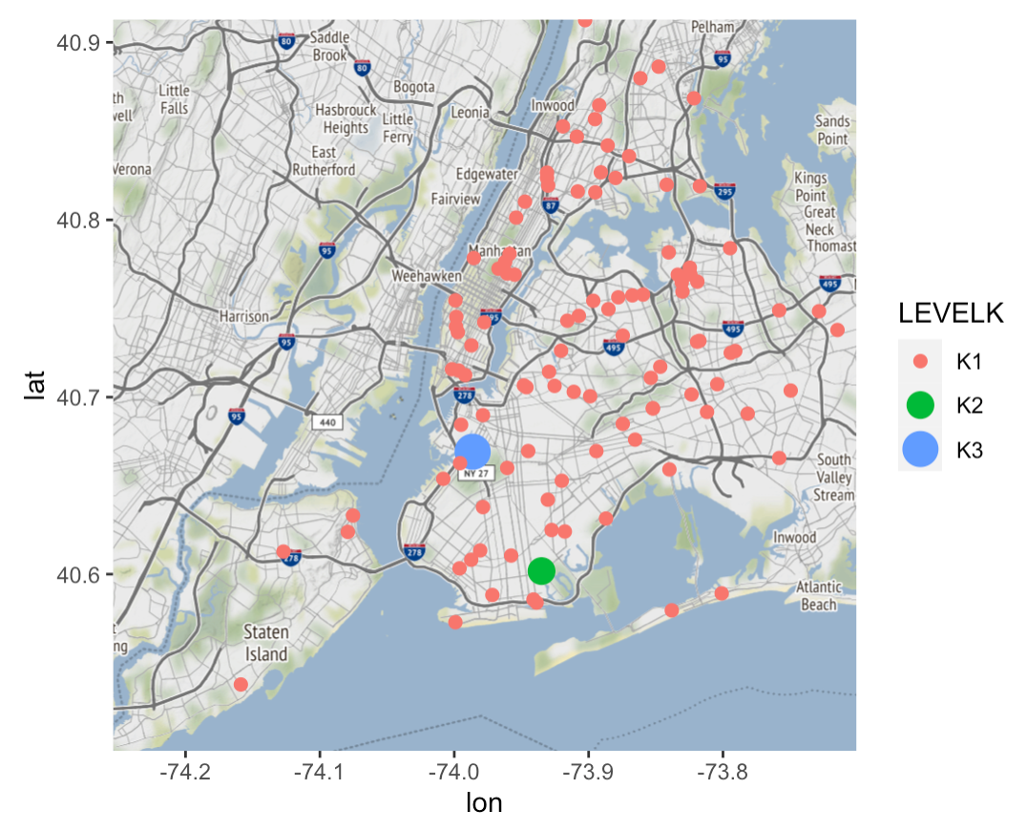
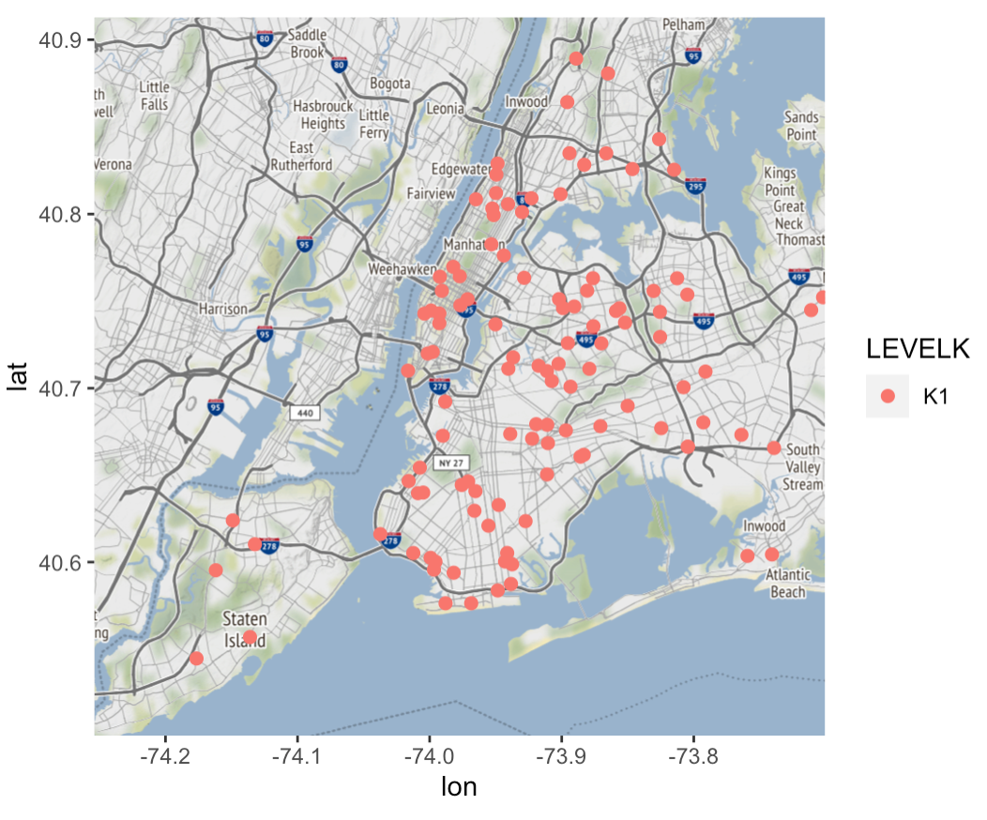
Geographic Pattern: Pedestrians Killed Levels
21
The maps below show the number of pedestrians killed.
Levels: 1, 2 and 3. Levels 1 and 2 represent the number of pedestrians killed, respectively.
Level 3 represents an incidents when a pedestrian is injured, and another is killed.
We can see that in 2019, there were a couple of incidents with 5 or more pedestrians injured while there were no such incidents in 2018
2018
2019

Slide 22
Models – Linear Regression and SVM
22
For our models, we wanted to:
Explore linear relationship between pedestrian injuries/deaths and our other variables using regression models
Predict whether a pedestrian injury/death would occur using SVM

Slide 23
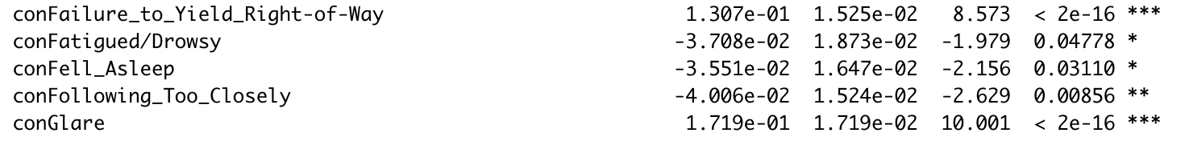
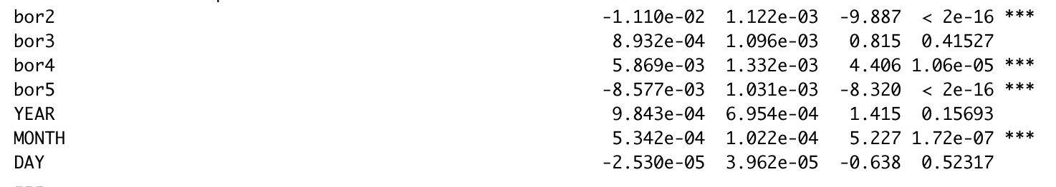
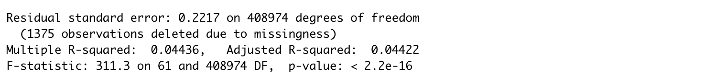
Regression
23
Trying to fit chaos into a linear model
R-squared is very low
Con --> contributing factor
Incidents and x variables aren't linear. When running linear regression, we don't expect adjusted r-squared would be high or significant.
Started with just Pedestrian and contributing factor and got adjusted-r squared of 4.4

Slide 24
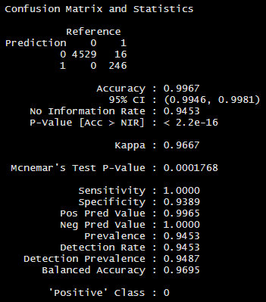
Predict Pedestrian Injury or Death
24
SVM model
Y variable: Pedestrian injury/death
0 = no injuries/death
1 = 1 or more injuries/death
X variables: Motorist deaths, motorist injuries, cyclist deaths, cyclist injuries
P-value: Statistically significant
No Information Rate: 94.5%
Accuracy: 99.6%
Model raises accuracy by 5%

Slide 25
25
Going beyond our scope: What about 2020?

Slide 26
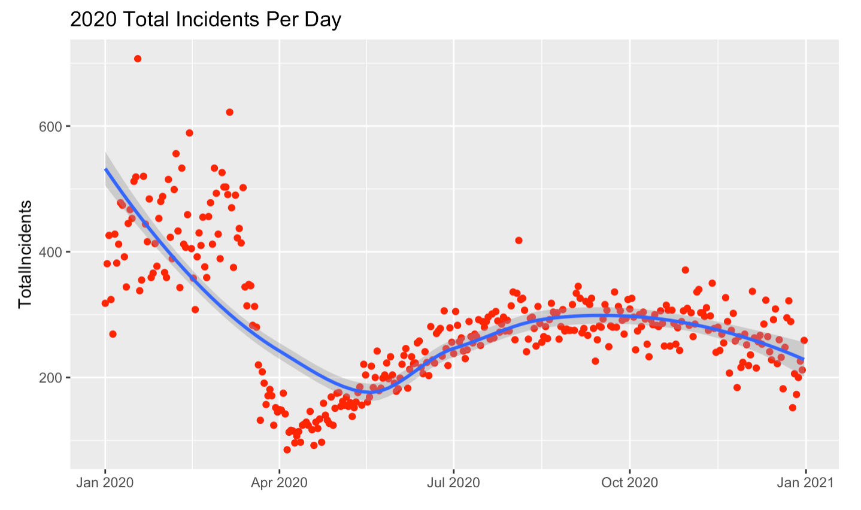
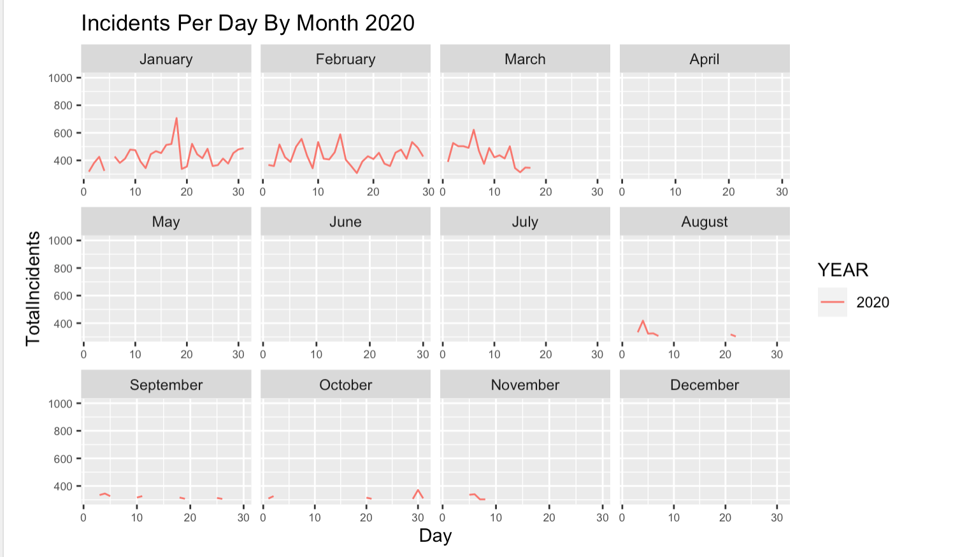
What about 2020?
26
Our data cleaning code works for any time section taken from the NYC Motor Vehicle Crashes. Using the same code, we imported in crash data for 2020. The data contains 112,893 incidents. We can see a huge drop in the total incidents between January 2020 and April 2020, then the total incidents follow an inverse parabola from July to Dec 2020. Looking closer, we can see that in the middle of March, around March 18th is when the total number of incidents drops off.

Slide 27
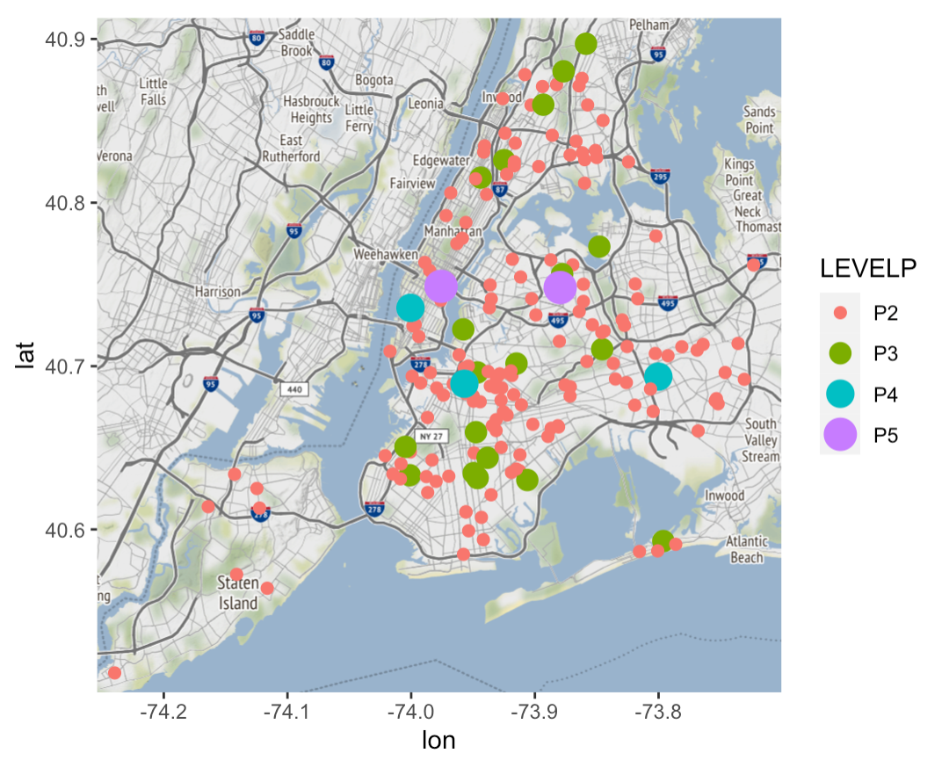
2018, 2019, and 2020
27
The maps below show the number of pedestrians injured. Levels: 1, 2, 3, 4, and 5. Levels 1-4 represent the number of pedestrians injured. Level 5 represents 5 or more pedestrians injured. Even though there were fewer incidents in 2020 from April to July, where the crashes occur still mirror that of 2018 and 2019
2018
2019
2020

Slide 28
Final Insights
28
2018 and 2019 trends for month, day, year, borough is all follow the same trends without many outliers.
Data is chaotic so linear predictions are weak – should try to merge with other traffic datasets to potentially strengthen predictors.
Our analysis provides a good foundation for extended analysis into 2020 to view changes caused by COVID-19.

Slide 29
Appendix

Slide 30
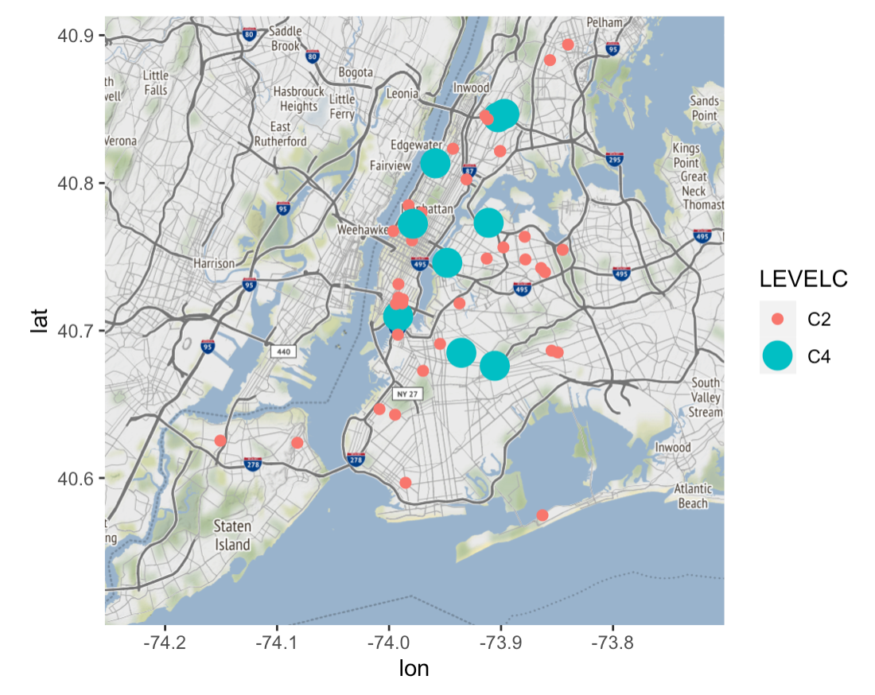
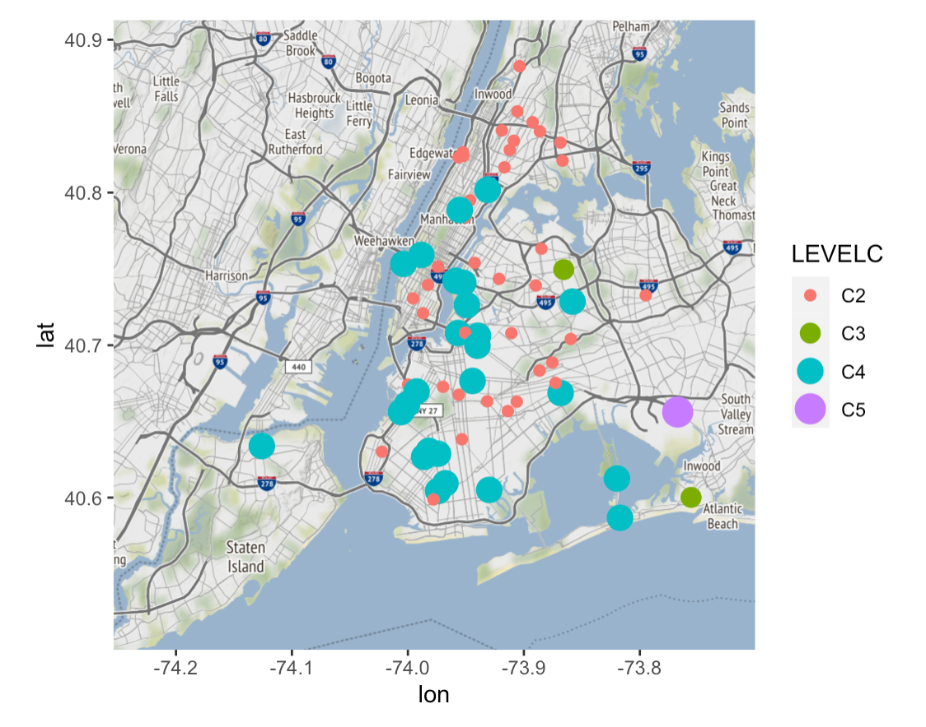
Cyclists Danger Levels
AP 01
2018
2019

Slide 31
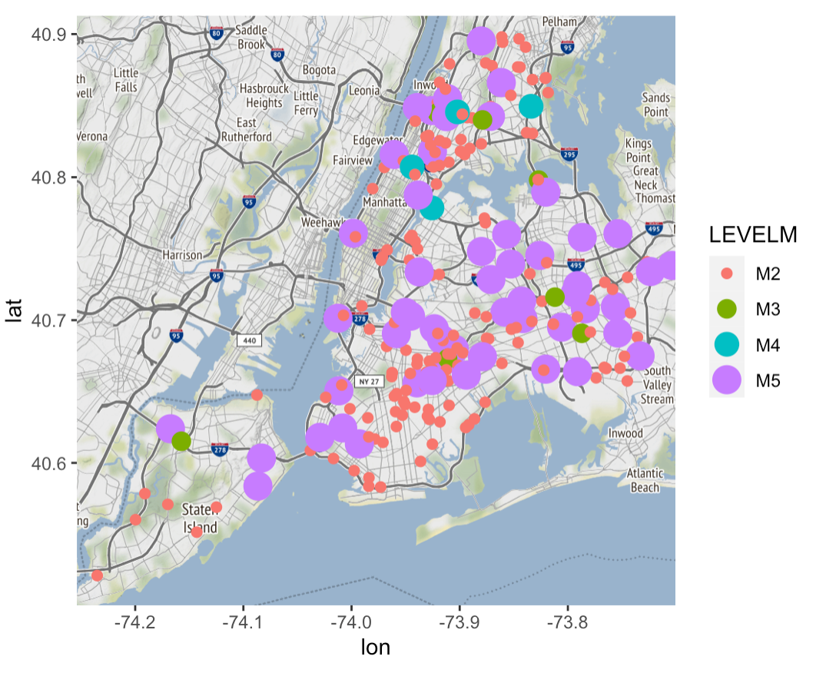
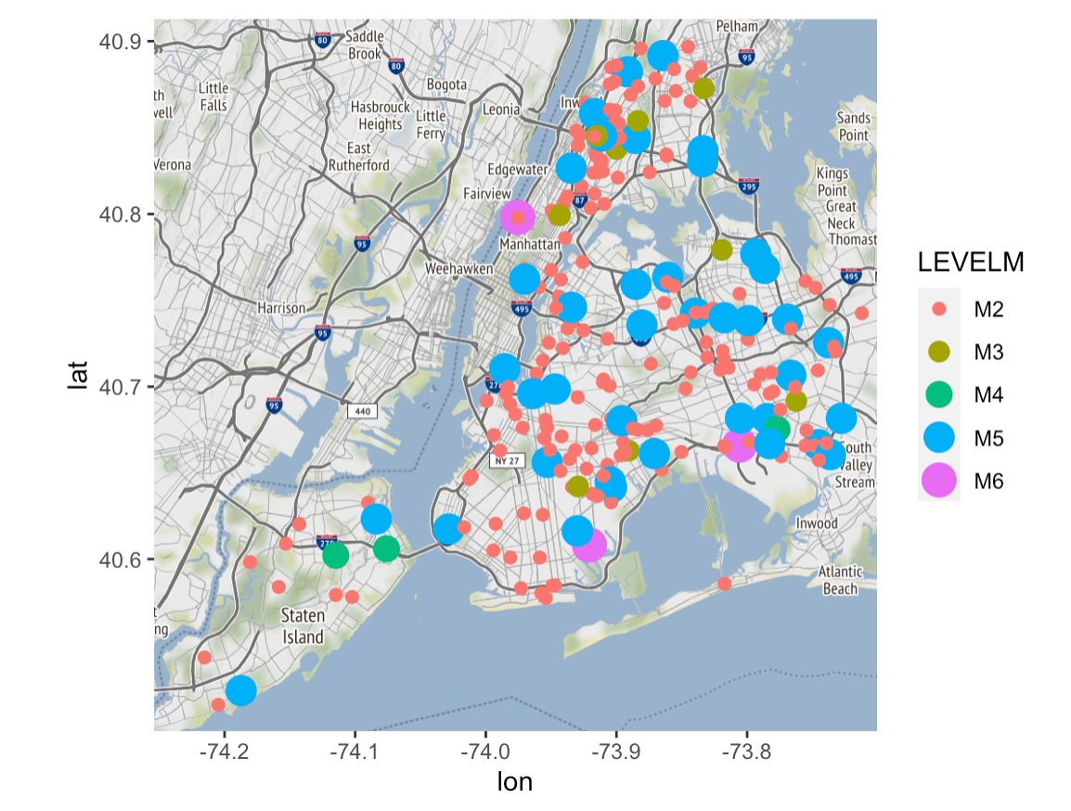
Motorists Danger Levels
AP 02
2018
2019

Slide 32
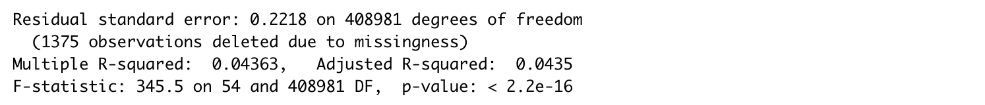
Regression 1
AP 03

Slide 33
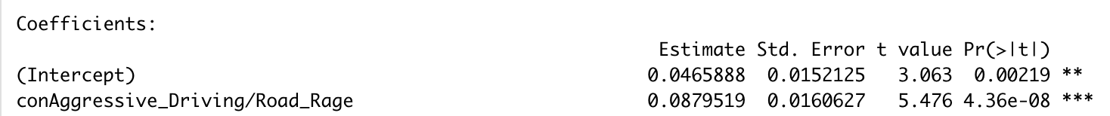
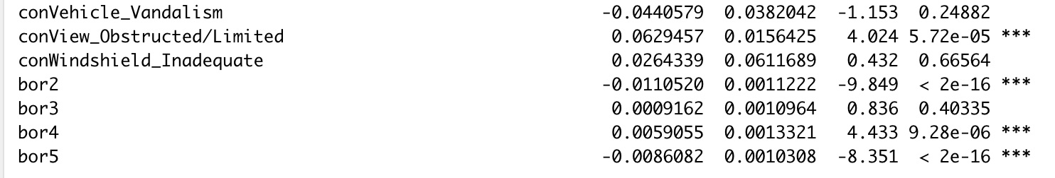
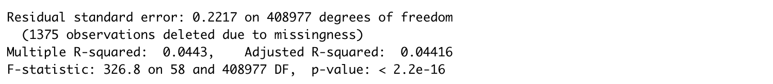
Regression 2
AP 04
to do

Slide 34
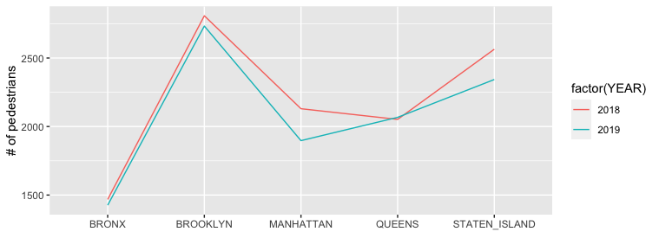
Trend of pedestrians injured by borough across 2018-2019
AP 06

Slide 35
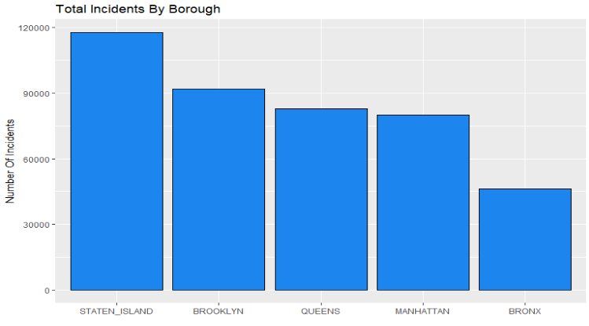
Incidents By Borough
AP 07

Slide 36
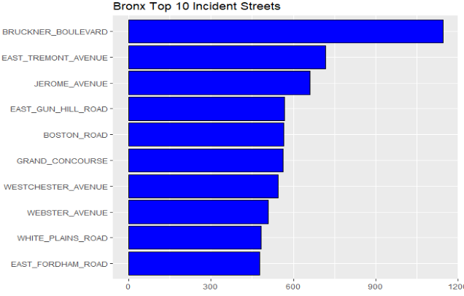
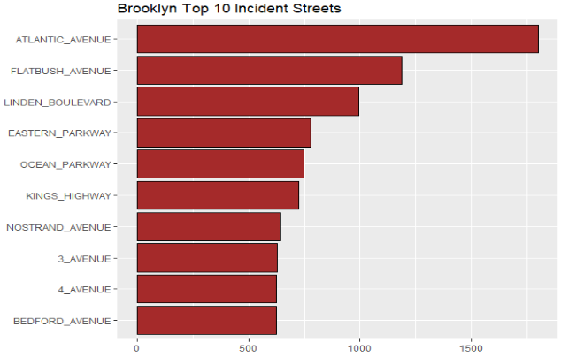
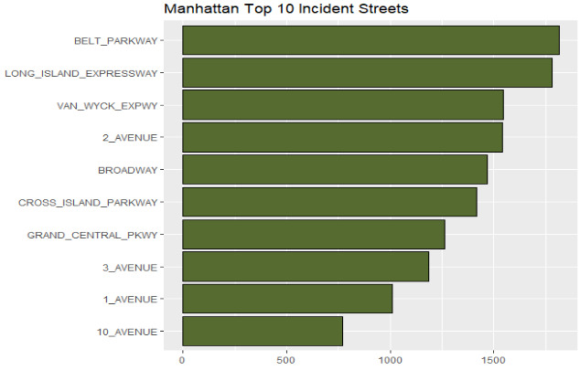
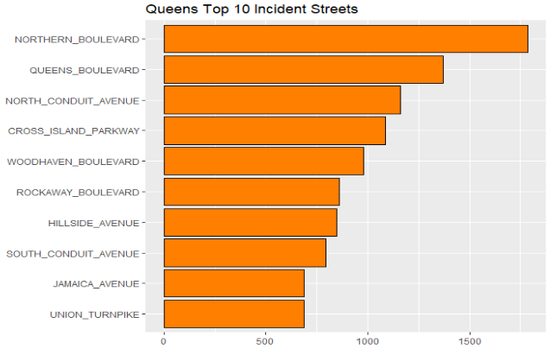
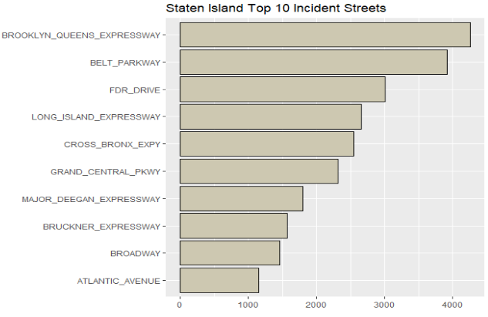
Top 20 Incident Streets Per Borough
AP 09

Slide 37
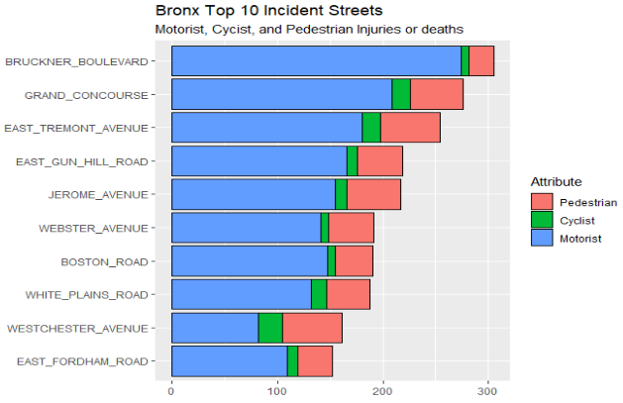
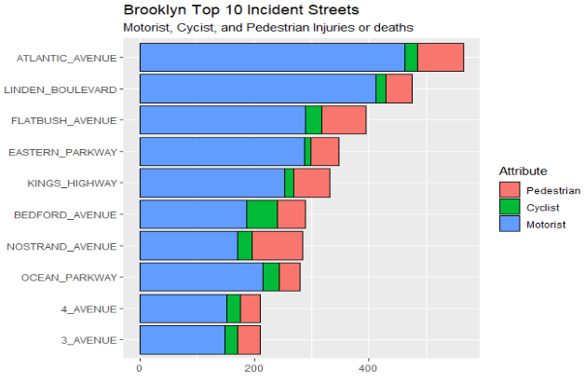
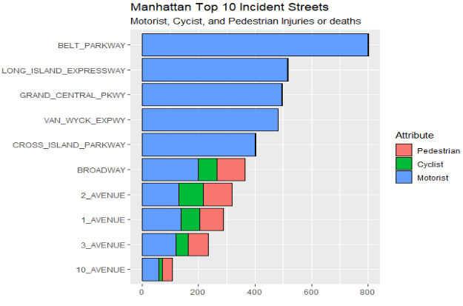
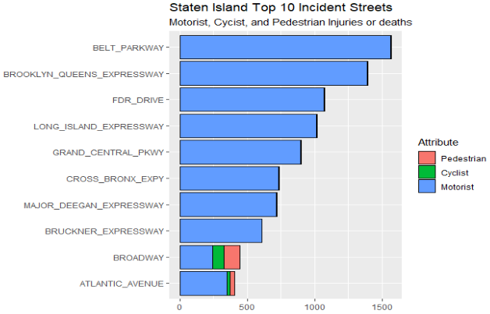
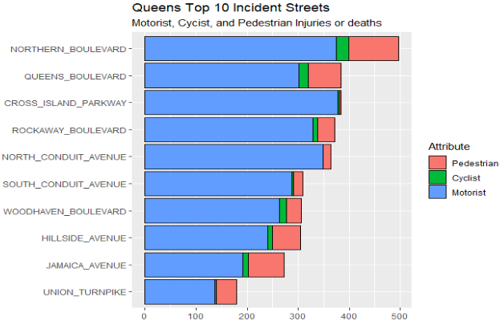
Top 20 Incident Streets – What type of deaths/injuries?
AP 10

Slide 38
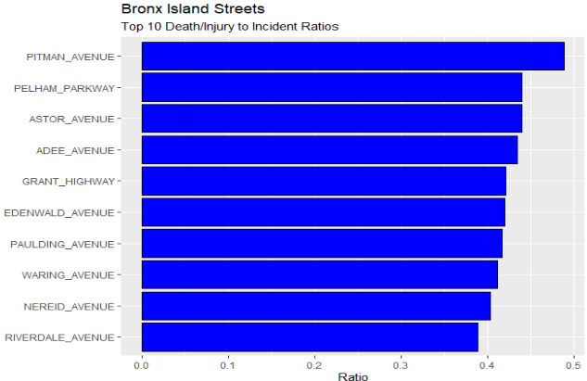
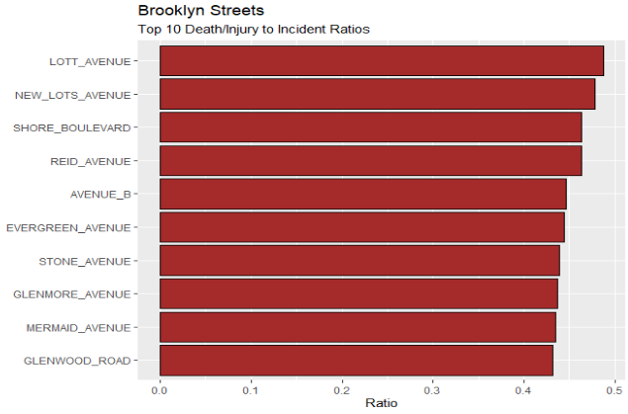
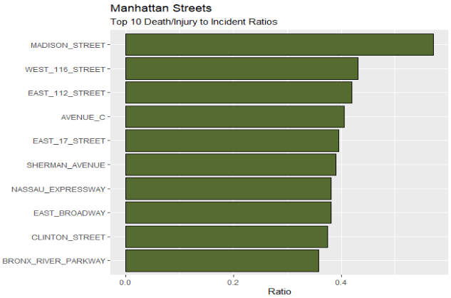
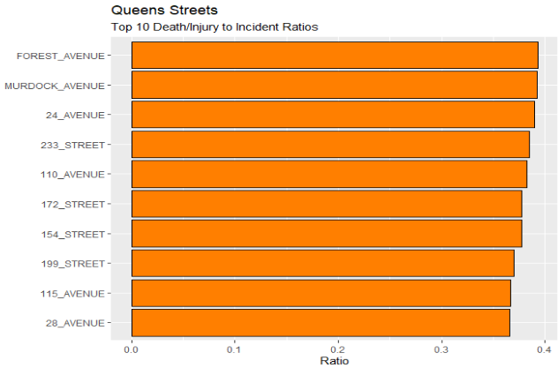

Top 20 Streets: Death/Injury to Incident Ratios
AP 11

Slide 39





Top 20 Death/Injury to Incident Ratios
AP 12

